Slide 1


Smart Water Leak Detection System Using ML and GIS
Om Godse(Team Lead)
Aditya Dhakne
Om Godse
Sukrut Kulkarni
Shaswat Haldar
Sarthak Narnor
College Name - VU
Notes:
Let's delve deeper into the exciting world of sustainability and AI.
In this chapter, we'll explore how artificial intelligence can be a powerful tool for addressing environmental challenges and promoting sustainable practices. We'll discuss specific applications of AI in various sectors and analyze its potential to drive positive change.
Get ready to discover the innovative ways AI is contributing to a more sustainable future!

Slide 2

Project Objectives
Problem Statement
Project Overview – Introduction
End Users
Wow Factor in Project
Modelling/Block Diagram/Flow of Project
Result/outcomes
Conclusion
Future Perspective
Notes:
Let's outline what you'll learn in this presentation.
By the end, you'll be able to:
Understand how AI helps solve problems like climate change, resource depletion, and biodiversity loss.
Identify key AI uses in energy efficiency, waste management, and climate change.
Analyze AI's role in sustainable agriculture and cities.
Evaluate AI's use in environmental monitoring using satellites, real-time data, and predictions.
Apply AI strategies in logistics and transportation to make them more sustainable.
Get ready to discover how AI can help create a greener future!

Slide 3
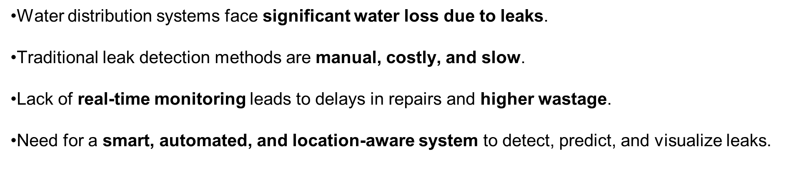
Problem Statement
Notes:
Sustainability and AI
Sustainability is important because it helps meet our needs now and in the future. It includes protecting the environment, reducing pollution, and improving economic and social well-being.
AI can help us achieve sustainability. AI can process data, make predictions, and optimize systems to solve problems like resource management, environmental conservation, and energy efficiency.
Examples:
Smart grids: Reduce energy consumption.
Agriculture: Optimize water and fertilizer use.
Biodiversity: Monitor wildlife to protect biodiversity.
AI is a powerful tool for creating a more sustainable future.

Slide 4
Project Overview - Introduction
Built a Streamlit-based dashboard for interactive monitoring.
Uses ML models (Random Forest, Decision Tree, Logistic Regression, SVM).
Input: Sensor readings (Pressure, Flow Rate, Temperature, Vibration, RPM, etc.) + GIS location
.
Features:
Leak prediction (single & batch)
What-if analysis with risk curves
Zone maps with leakage hot-spots
Analytics on feature importance & model comparison
Notes:
Sustainability and AI
Sustainability is important because it helps meet our needs now and in the future. It includes protecting the environment, reducing pollution, and improving economic and social well-being.
AI can help us achieve sustainability. AI can process data, make predictions, and optimize systems to solve problems like resource management, environmental conservation, and energy efficiency.
Examples:
Smart grids: Reduce energy consumption.
Agriculture: Optimize water and fertilizer use.
Biodiversity: Monitor wildlife to protect biodiversity.
AI is a powerful tool for creating a more sustainable future.

Slide 5
End Users
Municipal Water Authorities – monitor city-wide pipelines.
Smart City Projects – integrate into IoT infrastructure.
Industries & Housing Societies – reduce maintenance costs.
Environmental Agencies – reduce water wastage & ensure sustainability.
Notes:
Sustainability and AI
Sustainability is important because it helps meet our needs now and in the future. It includes protecting the environment, reducing pollution, and improving economic and social well-being.
AI can help us achieve sustainability. AI can process data, make predictions, and optimize systems to solve problems like resource management, environmental conservation, and energy efficiency.
Examples:
Smart grids: Reduce energy consumption.
Agriculture: Optimize water and fertilizer use.
Biodiversity: Monitor wildlife to protect biodiversity.
AI is a powerful tool for creating a more sustainable future.

Slide 6
Wow Factors in Project
Real-time leak detection with high accuracy (Random Forest ~99%).
Interactive What-if simulations for decision-making.
GIS-enabled maps showing zone-wise leak risk and dead pipes.
Batch processing for large-scale pipeline monitoring.
Model comparison dashboard for transparency and reliability.
Notes:
Sustainability and AI
Sustainability is important because it helps meet our needs now and in the future. It includes protecting the environment, reducing pollution, and improving economic and social well-being.
AI can help us achieve sustainability. AI can process data, make predictions, and optimize systems to solve problems like resource management, environmental conservation, and energy efficiency.
Examples:
Smart grids: Reduce energy consumption.
Agriculture: Optimize water and fertilizer use.
Biodiversity: Monitor wildlife to protect biodiversity.
AI is a powerful tool for creating a more sustainable future.

Slide 7
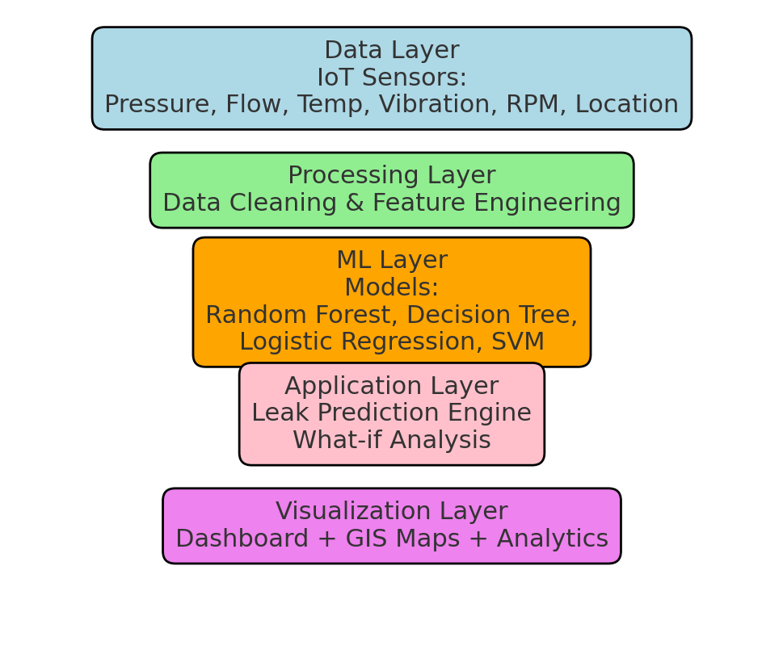
Modelling/Block Diagram/Flow of Project
Notes:
Sustainability and AI
Sustainability is important because it helps meet our needs now and in the future. It includes protecting the environment, reducing pollution, and improving economic and social well-being.
AI can help us achieve sustainability. AI can process data, make predictions, and optimize systems to solve problems like resource management, environmental conservation, and energy efficiency.
Examples:
Smart grids: Reduce energy consumption.
Agriculture: Optimize water and fertilizer use.
Biodiversity: Monitor wildlife to protect biodiversity.
AI is a powerful tool for creating a more sustainable future.

Slide 8
Result/Outcomes
Random Forest: 99%
Decision Tree: 95%
Logistic Regression: 93%
SVM: 94%
Feature Importance: Pressure, Flow Rate, and Temperature are top drivers.
GIS Maps: Showed zone-based leakage distribution and dead pipe detection
.
Analytics: Clear visualization of leak risks vs operating parameters.
Prediction Accuracy:
Notes:
Sustainability and AI
Sustainability is important because it helps meet our needs now and in the future. It includes protecting the environment, reducing pollution, and improving economic and social well-being.
AI can help us achieve sustainability. AI can process data, make predictions, and optimize systems to solve problems like resource management, environmental conservation, and energy efficiency.
Examples:
Smart grids: Reduce energy consumption.
Agriculture: Optimize water and fertilizer use.
Biodiversity: Monitor wildlife to protect biodiversity.
AI is a powerful tool for creating a more sustainable future.

Slide 9
Conclusion
Successfully developed a smart, ML-driven water leakage detection system.
Achieved high accuracy in predictions
.
Interactive dashboard empowers stakeholders with actionable insights.
System is scalable and adaptable to different water networks.
Notes:
Sustainability and AI
Sustainability is important because it helps meet our needs now and in the future. It includes protecting the environment, reducing pollution, and improving economic and social well-being.
AI can help us achieve sustainability. AI can process data, make predictions, and optimize systems to solve problems like resource management, environmental conservation, and energy efficiency.
Examples:
Smart grids: Reduce energy consumption.
Agriculture: Optimize water and fertilizer use.
Biodiversity: Monitor wildlife to protect biodiversity.
AI is a powerful tool for creating a more sustainable future.

Slide 10
Future Perspective
Integrate with real-time IoT sensor streams (cloud deployment).
Extend dataset for multi-city smart water networks.
Develop mobile app version for field engineers.
Use deep learning & anomaly detection for more complex leakage patterns.
Incorporate predictive maintenance (forecasting pipeline lifespan).
Notes:
Sustainability and AI
Sustainability is important because it helps meet our needs now and in the future. It includes protecting the environment, reducing pollution, and improving economic and social well-being.
AI can help us achieve sustainability. AI can process data, make predictions, and optimize systems to solve problems like resource management, environmental conservation, and energy efficiency.
Examples:
Smart grids: Reduce energy consumption.
Agriculture: Optimize water and fertilizer use.
Biodiversity: Monitor wildlife to protect biodiversity.
AI is a powerful tool for creating a more sustainable future.

Slide 11
Thank You
Notes:
Thank You !!

